Slide 1
Using myICLUB.com The World’s Most Popular Website for Investment Club Operations & Accounting
by ICLUBcentral Inc.
www.ICLUB.com
Copyright 2018 ICLUBcentral Inc
Notes:
Using myICLUB.com
These PowerPoint slides have been prepared by ICLUBcentral Inc. to provide instructions in the use of myICLUB.com at myiclub.com
Latest Revision Date:
23 April 2018
Copyright:
Copyright by ICLUBcentral, Inc., 2018
Target Audience:
Club members. Note that this presentation does not anticipate any knowledge of Club Accounting of any prior version.
Procedure Note:
“Click” indicates that a upon mouse click an animation will occur & the details for that animation follows.

Slide 2
What is myICLUB.com?
myICLUB.com is a web site for investment club operations with accounting tools built in.
myICLUB.com can be used to do accounting, communicate, & collaborate.
myICLUB.com is located at www.myiclub.com.

Slide 3
Why Use myICLUB.com?
All members have access to reports at all times.
You can email announcements & reports to members.
You can share & archive important documents, stock studies, meeting minutes, operating agreements.
You can keep track of club events on the shared calendar.
You can send & store club announcements.
You can conduct voting.
You can manage a stock watch list.
You can easily change treasurers by switching permissions.
Your data is automatically backed up in the cloud.

Slide 4
What Do I Need to Use myICLUB.com?
A computer (or tablet).
Running Windows, Apple OS, Unix, Android.
Access to the Internet.
Broadband speeds not required!
A web browser.
That’s it!

Slide 5
Is myICLUB.com Secure?
What myICLUB does: | What this means:
ICLUBcentral backs up myICLUB.com database every night. | Safer than your computer… when did you last back up everything?
Users can back up their club data to the cloud or on their own PCs. | Redundant backups provide additional protection.
ICLUBcentral uses industry standard security protective measures like SSL. | Every member has their own password… no user credentials are saved.
Servers are hosted in a secure, monitored location. | Servers are under lockdown, protected from infiltration.

Slide 6
How Much Is myICLUB.com?
45-day free trial to get you started.
Then choose subscription for unlimited members & transactions, & unlimited Technical Support :
1 year: $81.99.
2 year: $132.99.
Additional discount is available to StockCentral subscribers.
Optional Club Tax Printers can be purchased each year:
Federal: $89 (early bird price).
State: $89 (early bird price).

Slide 7
How Does myICLUB.com Work?
Administrator (usually a club officer) sets up a myICLUB.com site for the club.
Everyone in the club gets access to that site via their own individual username & password.
Club members can view accounting reports & other tools on the site.
Only designated officers can edit the accounting & other information.

Slide 8
How Do I Get Started?
Sign up for free 45-day trial at www.myiclub.com.
Set up myICLUB.com site for your club.
Import club data (if moving from Bivio or Club Accounting 3).
Add members’ info & email addresses.
Use “Invite” function to allow club members access to your private website.

Slide 9
Sign Up for myICLUB.com
Click on “Sign up” link at www.myiclub.com.
Enter name & email address.
Create username, password, & security question & answer.
TIP: You can use single email/password for multiple clubs!

Slide 10
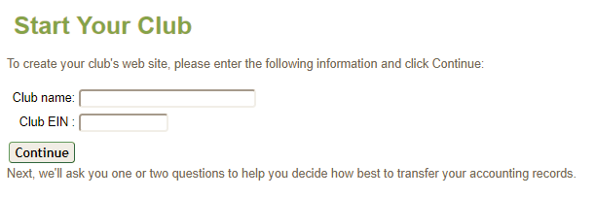
Set Up a Club Website
Enter your club name.
Enter your tax ID number (Employer Identification Number or EIN).
Leave blank if not yet acquired.

Slide 11
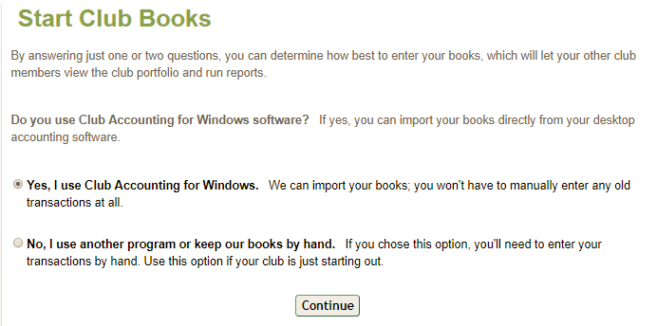
Start the Club Books
New clubs that haven’t used any accounting software can start entering transactions right away in Accounting area.
Clubs that use Club Accounting 1.04, 2.x, or 3.x, or Bivio.com can import it.

Slide 12
Import Accounting Records
Export data from accounting program.
Find export file by ‘browsing’ to it from myICLUB.com import page,
Click ‘Import’ button.

Slide 13
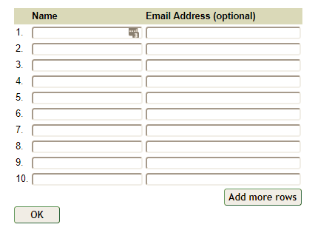
Invite the Club Members
Step #1: Enter the member names. If you have imported your data, these will be pre-filled.
Step #2: Enter member email addresses. (optional)
Step #3: Click ‘OK’. Members will receive an email invitation with instructions for how to join the myICLUB.com site & create their own usernames & passwords.

Slide 14
You’re Done!
(Actually, it’s easier than that – myICLUB.com will guide through these steps one by one.)

Slide 15
Logging In
Go to www.myICLUB.com....
…just like logging in to most web sites.

Slide 16
Your Club Home Page

Slide 17
Navigating myICLUB.com
Follow the Menu at the top of every page:
Accounting
Watch
List
People
Message
Boards
Help
Calendar
Reports
Voting
File
Storage
Taxes

Slide 18
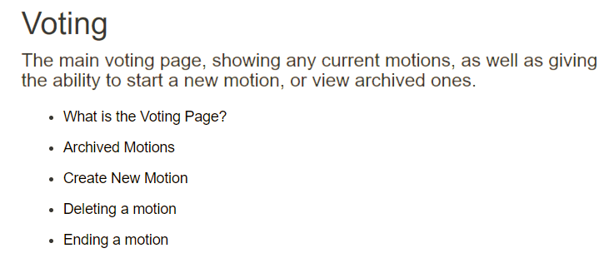
Help
Click Help on any page for context-sensitive help about the tools on that page.
Help

Slide 19
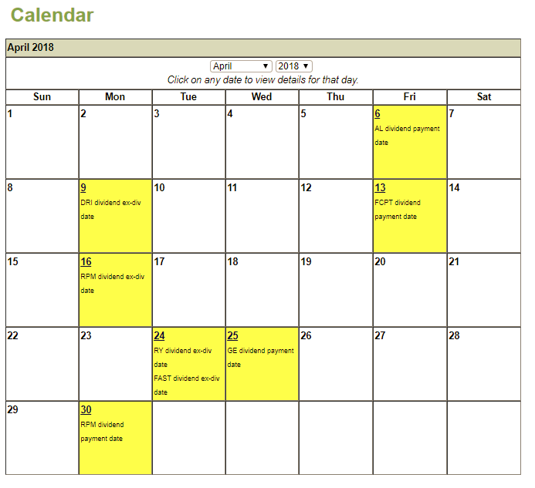
The Calendar
Enter & maintain one-time & recurring club events. Portfolio events are added automatically. Can also display ICLUB events like webinars & conferences!
Calendar

Slide 20
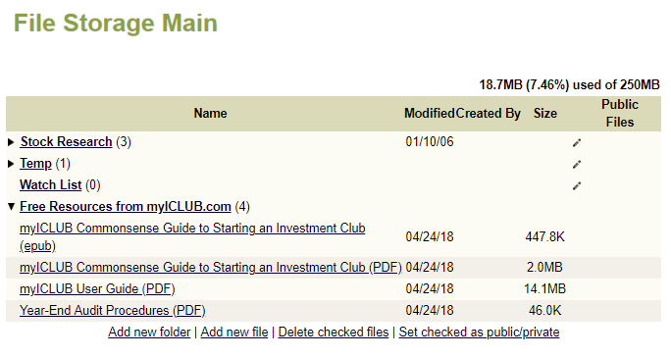
The File Storage Area
Store & share documents, stock studies, minutes. Make certain files publicly accessible. Download free educational e-Books & resources from ICLUBcentral.
File
Storage

Slide 21
Sharing Files with Members
Files are organized into folders. Expand folder by clicking arrow.
Add files by clicking on ‘Add new file.’
Download a file by right-clicking on it.
Rename or delete a file by clicking on ‘rename/move’ or ‘delete.’

Slide 22
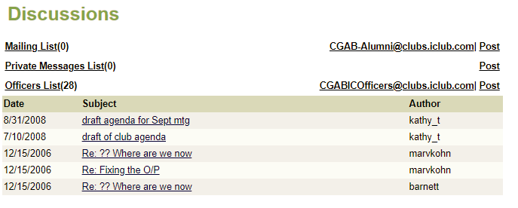
Message Boards
Post messages to share with your club via email threads. Can set up multiple message boards!
Message
Boards

Slide 23
Message Boards
Can post messages via your web browser.
Or post via email (every message board has an email address you can send to).
All messages posted by club members are archived on the site for quick access.
Messages are also sent to your email.

Slide 24
Voting
Can create ballots for voting in between meetings or for online clubs. Support many methods of tabulating results. Automatically email members with ballots & results.
Voting

Slide 25
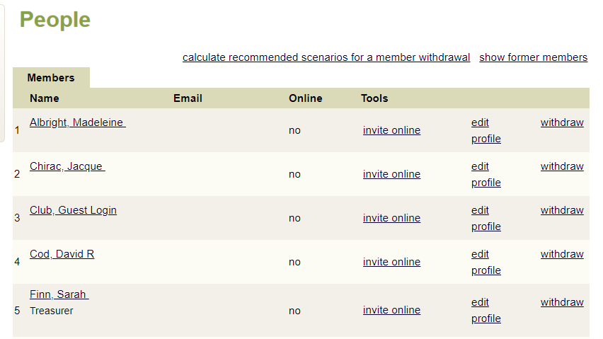
The People Page
Review membership & contact information. Invite new members & guests. Set user roles.
People

Slide 26
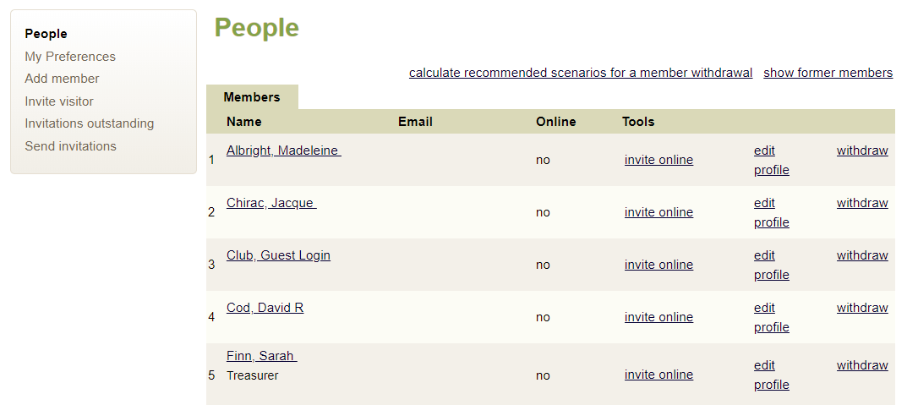
People
Bring people into club by clicking ‘invite online.’
Check on outstanding invitations.
Edit contact information with ‘edit profile.’
Add new members or visitors.

Slide 27
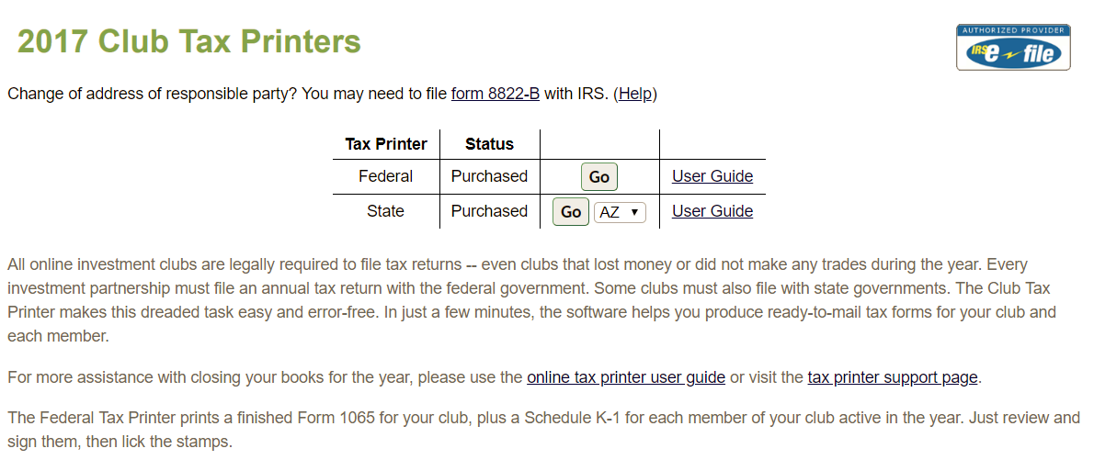
Taxes
Federal Club Tax Printer & State Club Tax Printer (for 14 states) available for purchase each year. IRS e-Filing now available with purchase at no additional cost!
Taxes

Slide 28
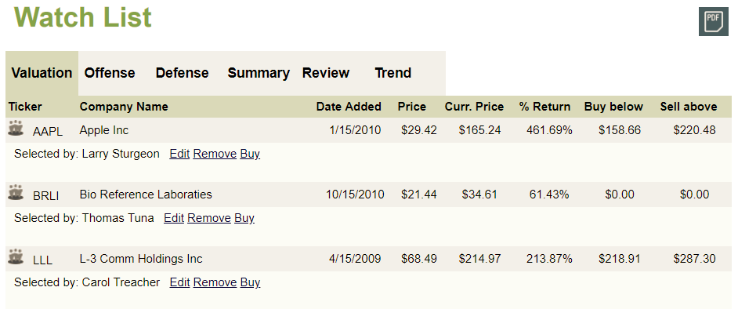
Watch List
Keep track of stocks to watch, or hold stockpicking contest.
Watch
List

Slide 29
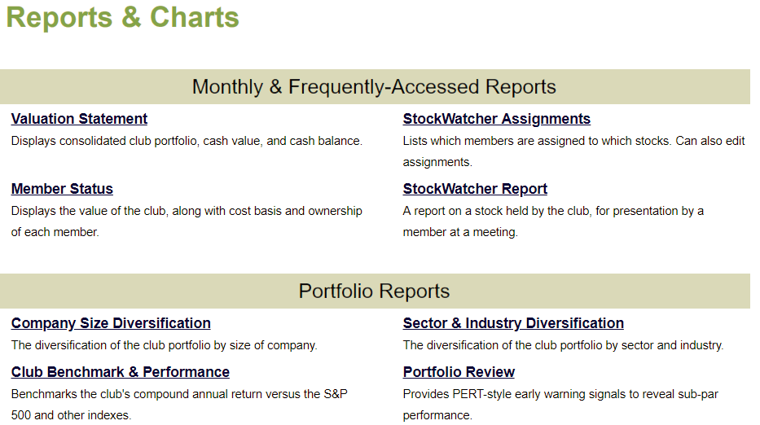
Reports
More than 35 reports & graphs! All members can access at any time (only treasurer can change data).
Reports

Slide 30
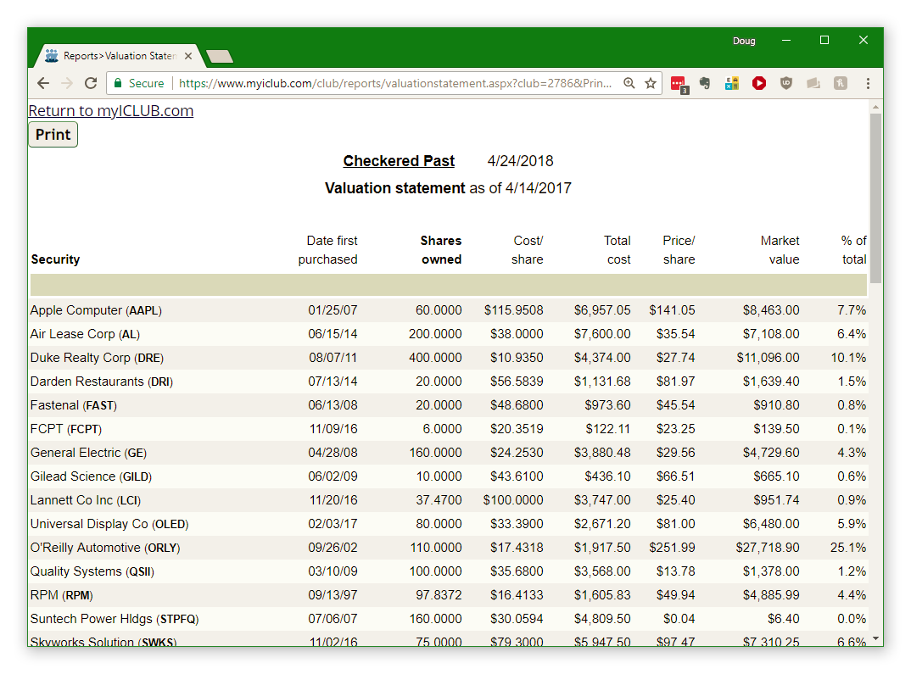
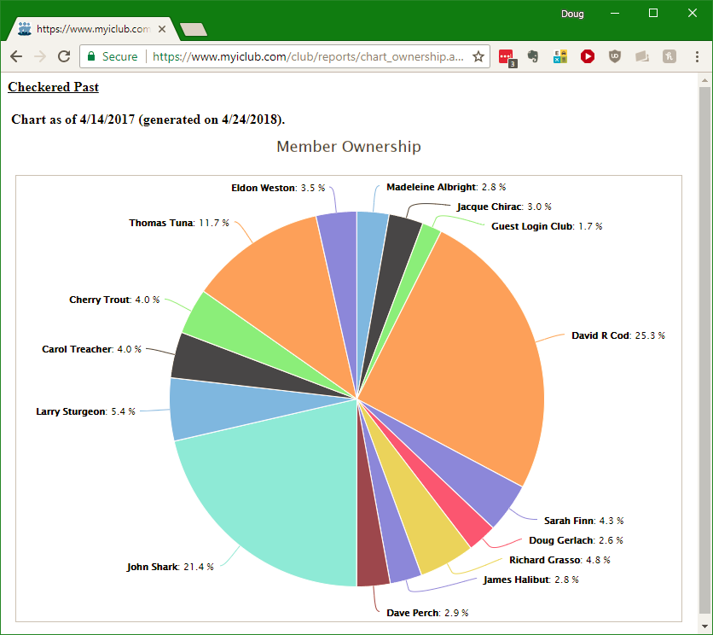
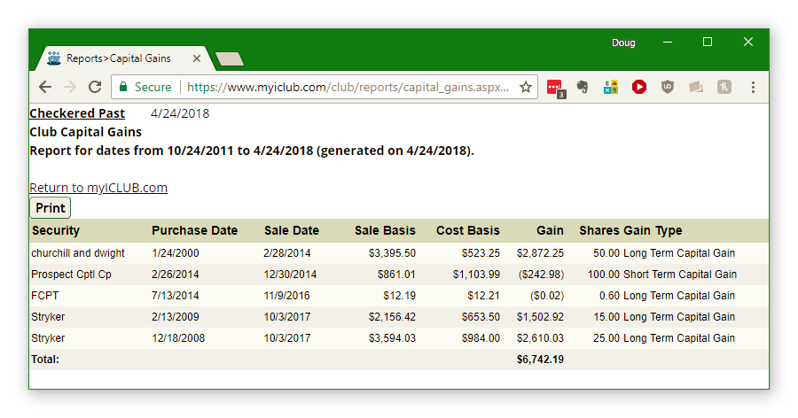
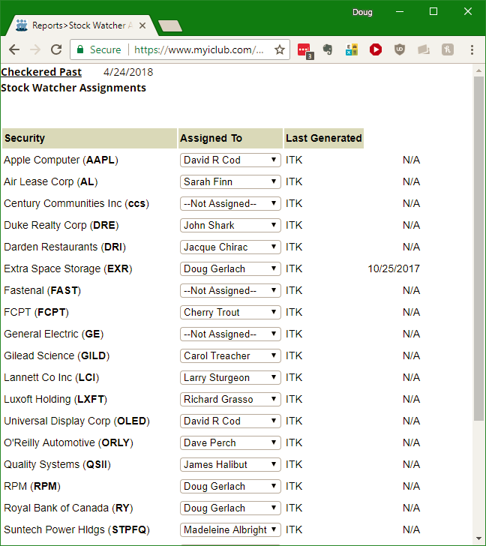
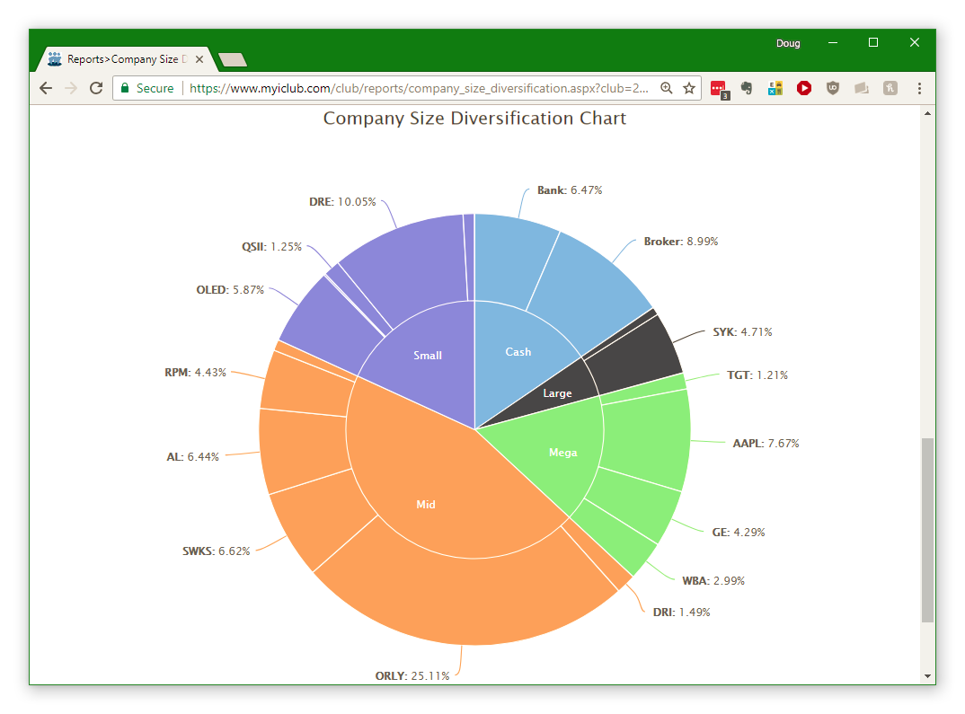
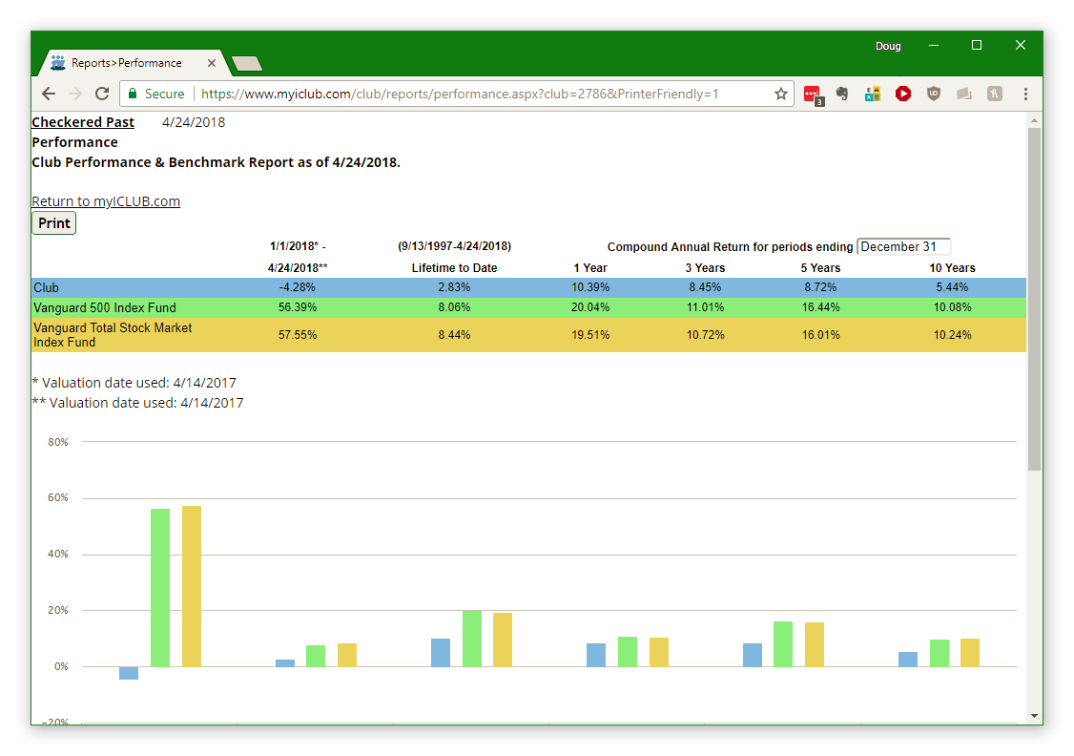

Slide 31
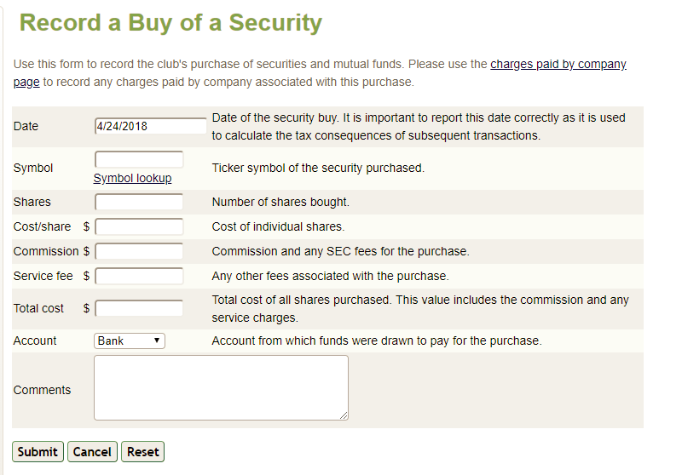
Accounting
Unit-value accounting keeps track of all security & member transactions. Only treasurer (& co-treasurer or assistant treasurer) can edit data, but all members can view.
Accounting

Slide 32
Accounting
Main Accounting page gives a snapshot of club finances
Portfolio holdings.
Accounts & available cash.
Each member’s account value.
Unit value of club.

Slide 33
Need Help?
Click on “Help” at top of any page for context-sensitive assistance about that page.
Check out the Frequently Asked Questions at www.iclub.com/faq/.
Request assistance at www.iclub.com/support/.
Download myICLUB.com manual.

Slide 34
myICLUB.com The World’s Most Popular Website for Investment Club Accounting & Operations.
Learn more at www.myICLUB.com
Copyright 2018 ICLUBcentral Inc

